Slide 1


Presentation Topic: History of Internet
Course Title: English Language and Literature
Course Code: ICT-1211
Presented By:
Haseba Muntaha
ID:IT-25013
Department of Information and Communication Technology,
Mawlana Bhashani Science and Technology University
Submitted To:
Dr. Nazrul Islam
Associate Professor,
Department of Information and Communication Technology,
Mawlana Bhashani Science and Technology University

Slide 2
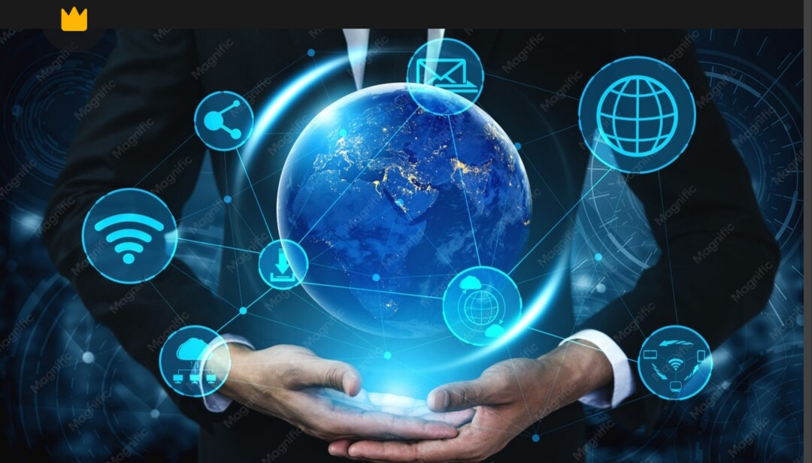
What is Internet ?
The Internet is a global network of interconnected computers that communicate with each other.
It has revolutionized communication, information access, and everyday life.
Source:https://img.freepik.com/premium-photo/5g-communication-technology-wireless-internet-network-global-business_31965-14383.jpg

Slide 3
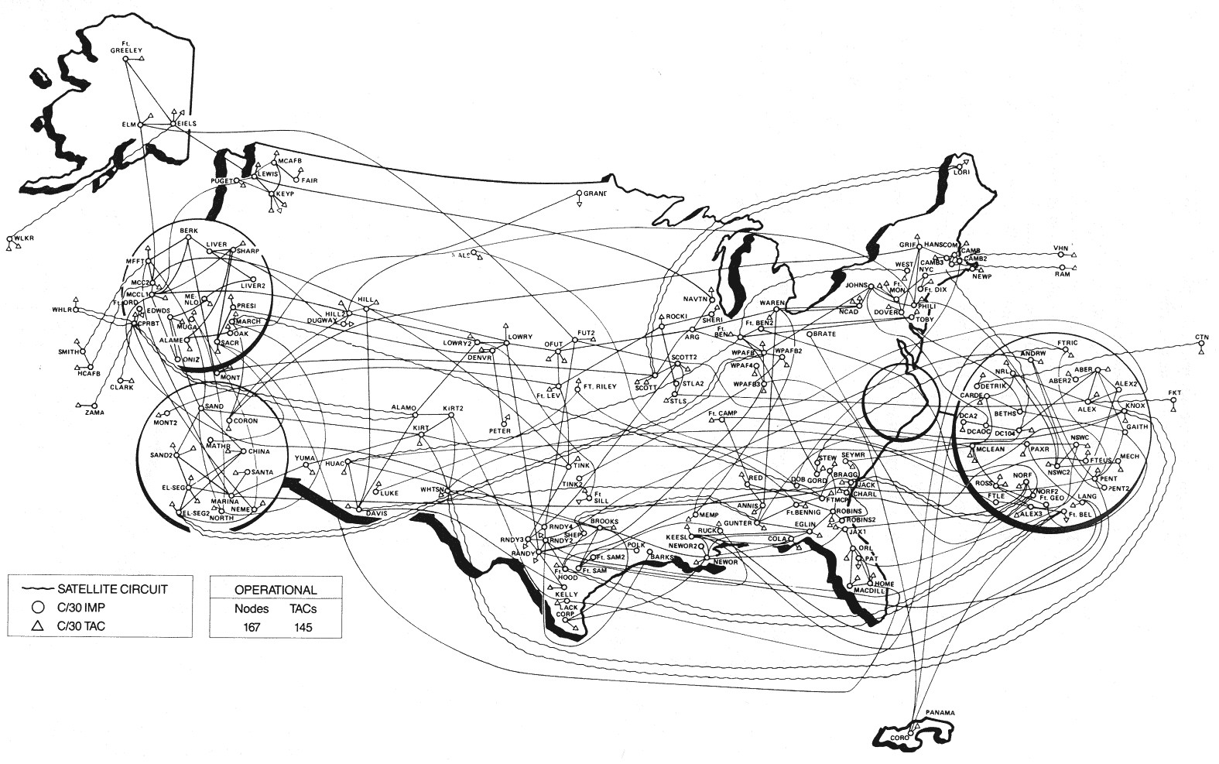
The Genesis – ARPANET Origin:
Origin: The precursor to the Internet.
Developed by the Advanced Research Projects Agency (ARPA).
Timeline: Late 1960s.
Purpose: Research and military communication.
Source:https://upload.wikimedia.org/wikipedia/commons/9/94/MILNET-US-Geographical-1989.jpg

Slide 4
Foundational Technologies
Packet Switching:
Data is divided into small packets.
These packets travel independently and are reassembled at the destination.
TCP/IP Protocol:
Developed by Vint Cerf and Bob Kahn in the 1970s.
It stands for Transmission Control Protocol/Internet Protocol and is the standard for communication.

Slide 5

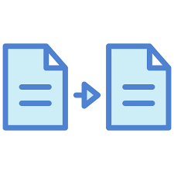
Early Applications
Electronic Mail
Created by Ray Tomlinson in 1971, introducing the "@" symbol to separate user and host.
File Transfer
Allowed users to transfer files and access remote computers directly from their terminal.

Slide 6
The Dawn of the World Wide Web
Invented by Tim Berners-Lee at CERN in 1989.
Key Innovations:
HTML – Structure of web pages
HTTP – Transfer protocol
URL – Web addresses

Slide 7
Browsers – Opening the Web
Browsers are software used to access and view web pages.
Early browsers included: Mosaic, Netscape Navigator, and Internet Explorer.
They made the web accessible to the general public.

Slide 8
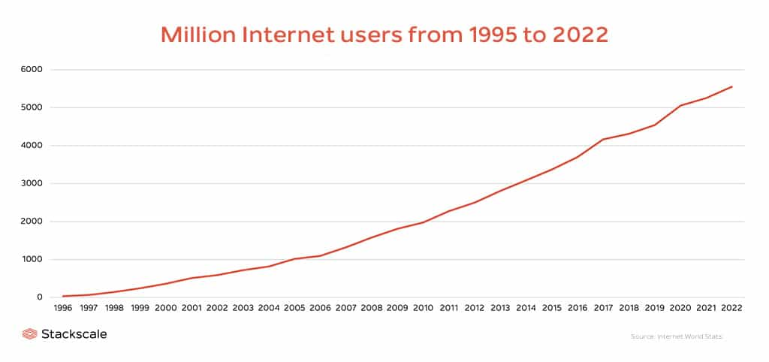
Expansion and Commercialization
NSFNET helped expand Internet access beyond research institutions.
In the mid-1990s, privatization allowed commercial ISPs to provide access.
The late 1990s saw the dot-com boom, followed by a market correction
Source: https://www.stackscale.com/wp-content/uploads/2023/05/Million-Internet-users-1995-2022-Stackscale.jpg

Slide 9
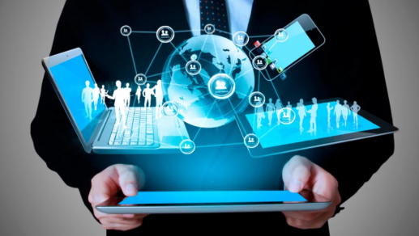
The Modern Internet
Today, the Internet is accessible everywhere through mobile devices and broadband.
Key developments include: Social Media, Cloud Computing, and the Internet of Things (IoT).
Source:https://www.newyorkecommerceforum.com/oawiwart/2018/06/The-role-of-the-internet-in-the-modern-era.png

Slide 10
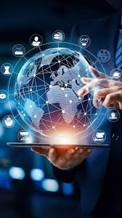
Future Trends
Artificial Intelligence (AI) will enhance services like search and recommendations.
5G will provide faster connectivity.
IoT and virtual worlds (Metaverse) will continue to grow.
Source:https://www.freepik.com/premium-ai-image/global-business-network-connection-around-digital-globe-internet-things-iot-concept-internat_321024421.htm

Slide 11
Conclusion
The Internet has evolved from ARPANET to a powerful global system. It continues to grow and shape the future of communication and technology.

Slide 12

THANK YOU

